Slide 1




WingS
Member
Content
WingS Capstone Project
“We make a living by what we get, But we make a life by what we give.”
-Winston Churchill-

Slide 2
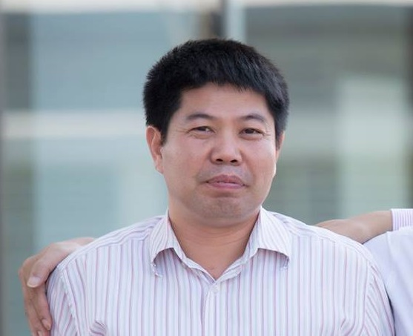
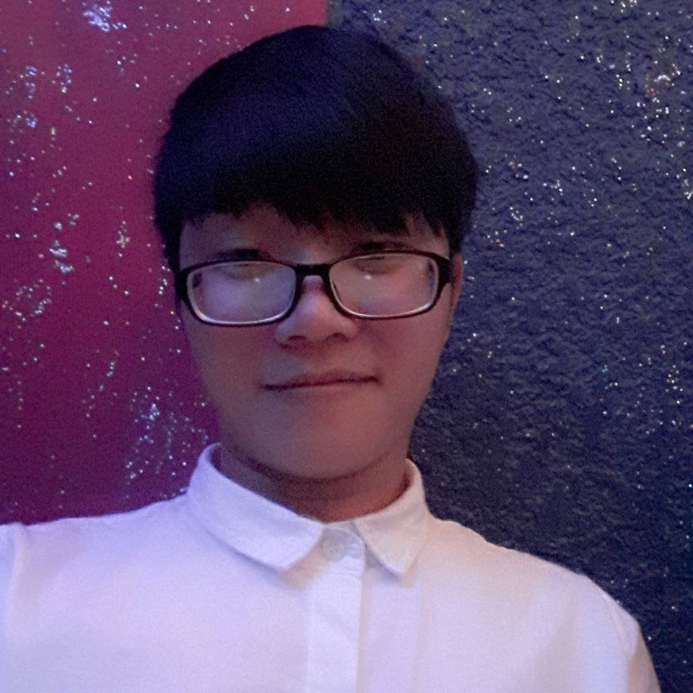



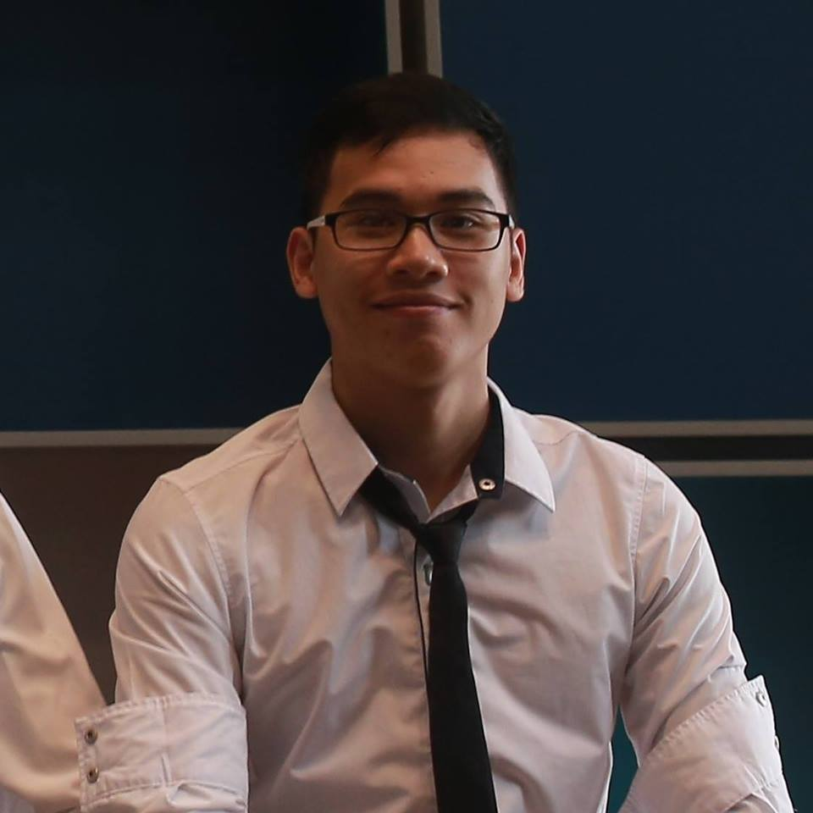
WingS
Member
Content
Supervisor - 指導教員
Lecturer Nguyen Van Sang
Team member -チームメンバー
Dao Trong Nghia– SE03220
Le Hong Nhien – SE03377
Ta Ngoc Duy – SE03267
Do Van Tuan – SE03297
Hoang Anh Tuan – SE03108

Slide 3
WingS
Member
Outlines
Outlines -アウトライン
Introduction - 導入
Project Management - プロジェクト管理
Software Requirement Specification -プロジェクト管理
Software Design Description -ソフトウェア要求仕様
Quality Control -品質管理
Project Result -プロジェクト結果
Demo -デモ
Q & A -質問と回答

Slide 4



1. Introduction - 導入
1.1 Current Situation
1.2 The Idea
1.3 Proposal
Introduction
Project Management
SRS

Slide 5


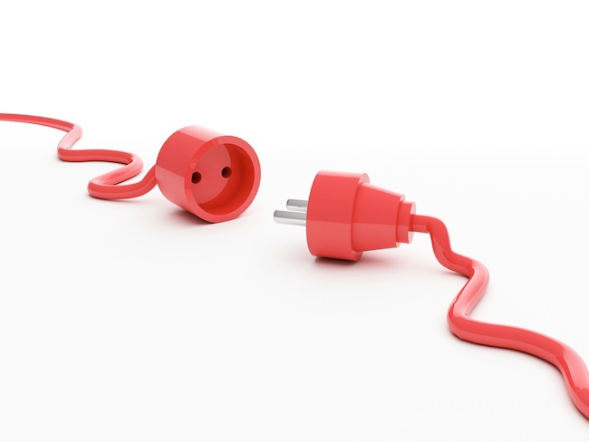
1.1 Current Situation - 現在状況
There are many charity organizations in Vietnam
Introduction
Project Management
But few of them can make connections between the charity organizations and people who need help.
SRS

Slide 6
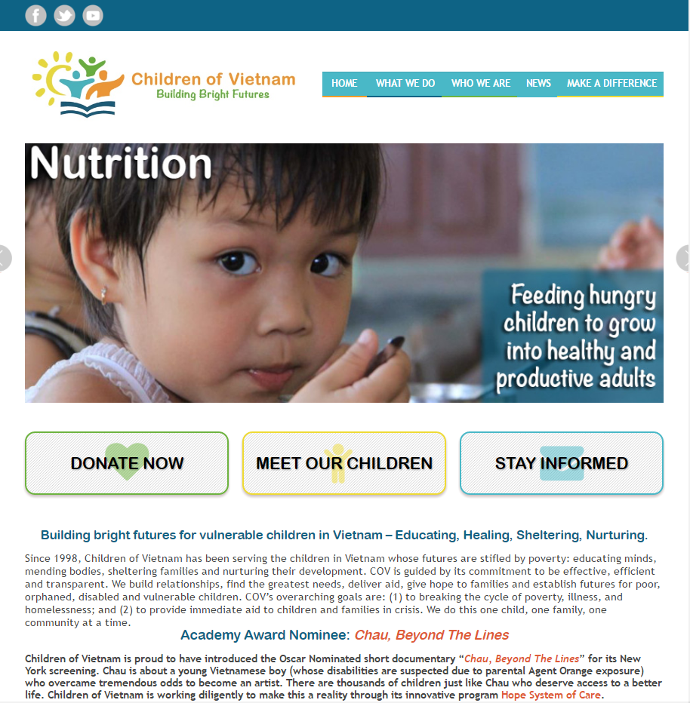
1.1 Current Situation - 現在状況
Childrenofvietnam.org
Advantages:
Has friendly user interface
Disadvantages:
Only support PayPal. The language is English.
No marketing or advertising so it is not popular in Vietnam.
Only about children.
Introduction
Project Management
SRS

Slide 7
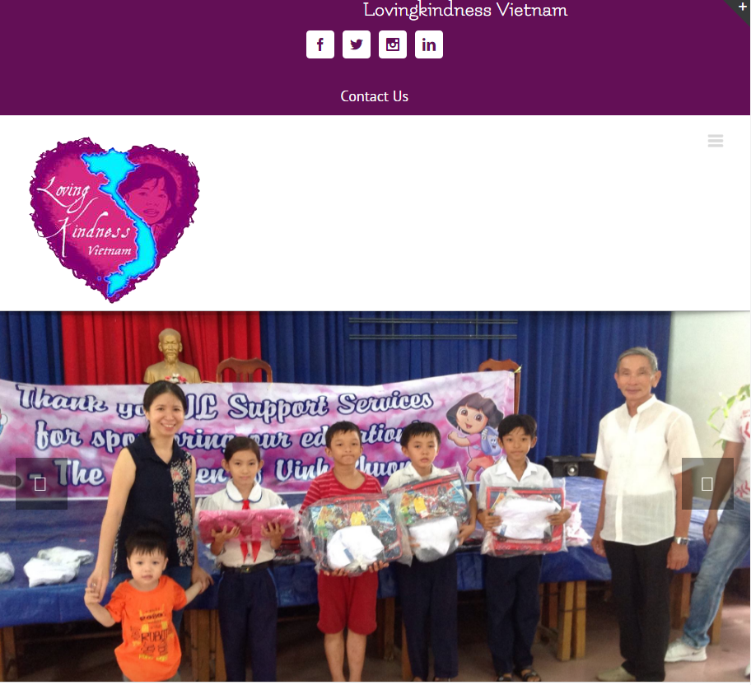
1.1 Current Situation - 現在状況
Lovingkindnessvietnam.org
Introduction
Advantages:
Has friendly user interface.
Disadvantages:
Only support PayPal. The language is English.
No marketing or advertising so it is not popular in Vietnam.
Project Management
SRS

Slide 8


1.2 The Idea - アイデア
Build a website allow
Raise money for charity.
Connecting donors, organization and people who need help.
Introduction
Project Management
SRS

Slide 9
1.3 Proposal - 提案
Build a website
Used technology .NET MVC5, AngularJS...
Help raise charity, connecting donors, organizations, people who need help.
Completely support Vietnamese user.
Improve team member
Development, management, teamwork skill
Technical experience
Introduction
Project Management
SRS

Slide 10
2. Project Management -プロジェクト管理
Introduction
Project Management
Come up next: Do Van Tuan
SRS

Slide 11
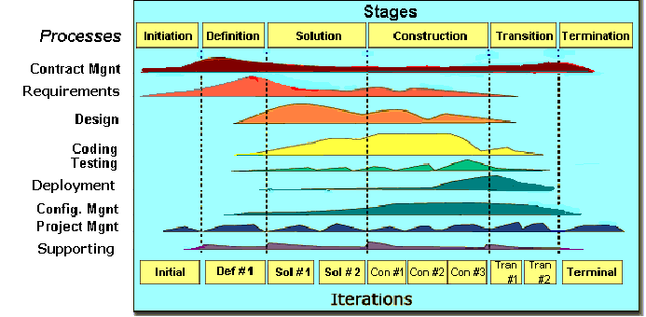
2.1 Software Process Model -ソフトウェアプロセスモデル
Introduction
Project Management
SRS
FPT Software process model

Slide 12
2.1 Software Process Model -ソフトウェアプロセスモデル
Initiation | Identify business functions of the system Determine scope, condition, limitation, project risk List main functions Complete Report #1 (Project Introduction, Project Plan, SRS)
Solution | Complete SRS, Architecture Design and Database Design Complete Report #2 (Architecture Design, Screen Design, Database Design, Class/Component Design), Report #3 (Test Plan, Test Cases)
Construction | Complete Coding and Testing Complete Report #4 (Source codes, UT Cases), Report #5 (Test Report, Quality Report)
Termination | Complete software packages and Report #6 Preparing presentation Complete Project
Introduction
Project Management
SRS

Slide 13
2.2 Project Organization -プロジェクト組織
Introduction
Nguyễn Văn Sang
Instructor
Đào Trọng Nghĩa
Project Manager
Project Management
Lê Hồng Nhiên
Tạ Ngọc Duy
Đỗ Văn Tuấn
Technical Leader
Test Leader/QA
Design Leader
Đỗ Văn Tuấn
Tạ Ngọc Duy
Đào Trọng Nghĩa
Hoàng Anh Tuấn
Đỗ Văn Tuấn
Đào Trọng Nghĩa
Developer
Developer
Developer
Developer
Tester
Designer
SRS

Slide 14
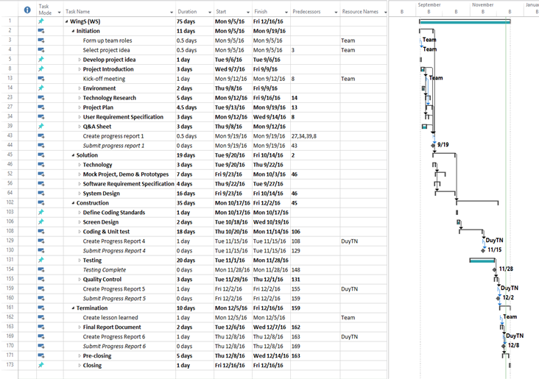
2.3 Project Schedule - プロジェクト計画
Introduction
Project Management
SRS

Slide 15
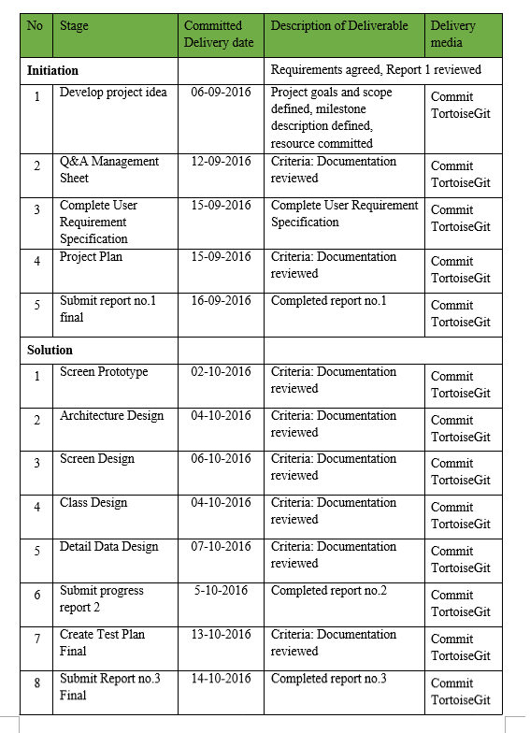
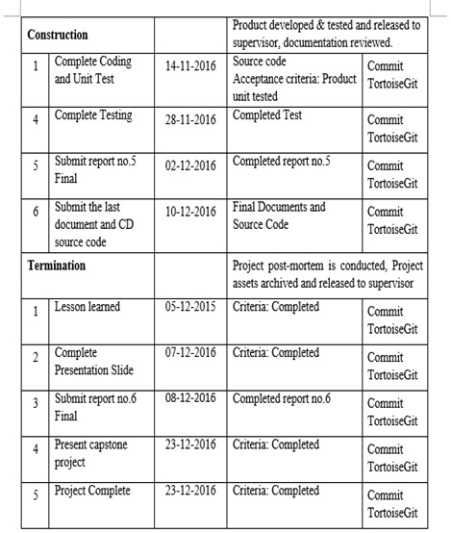
2.4 Objectives & deliverables -目標と成果物
Introduction
Project Management
SRS

Slide 16










2.5 Tools & Infrastructure - ツールと インフラストラクチャ
Tools
Tools for project management
Tools for developing
Introduction
TortoiseGit
Word 2013
Excel 2013
Project 2013
Power Point 2013
Project Management
SRS
Visual studio 2013
Chrome
Firefox
Sublime Text
SQL Server

Slide 17
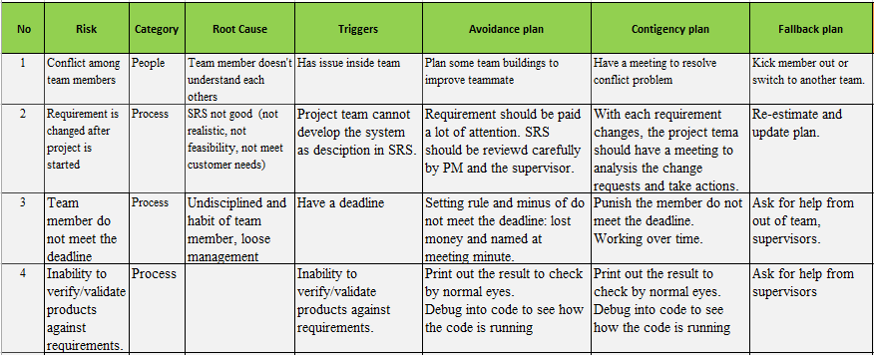
2.6 Risks management -リスク管理
Introduction
Project Management
SRS

Slide 18
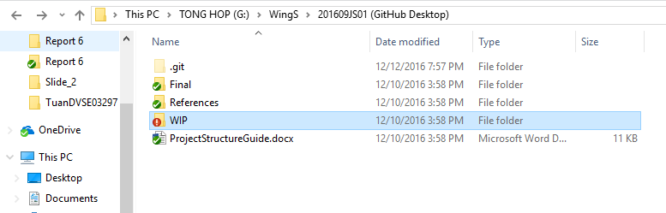
2.7 Configuration management - コンフィグレーション管理
Final: Store sent and delivered documents
References: Store reference documents. For example: templates, technologies document…
WIP: Store documents in progress developing
Plan: Plan of capstone project
Users: Working Folder of Member
Documents: Store whole documents in progress developing
Records: Store documents like Meeting Minutes, Q & A Management…
Introduction
Project Management
Folder structure of project
SRS

Slide 19
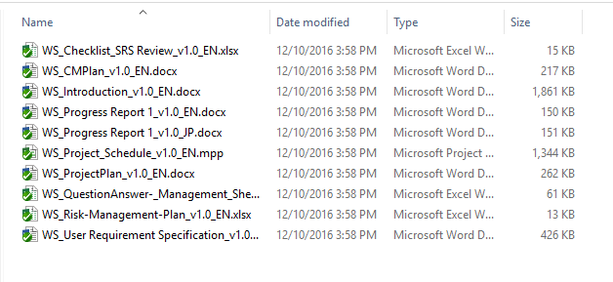
2.7 Configuration management - コンフィグレーション管理
Rule: ProjectCode_Document’s name_v<x.x>_language
ProjectCode: WS
Document’s name: Architecture Design, Class Design…
v<x.x>: document’s version. For example: v1.0, v1.1,…
Language:
EN: English
JP: Japanese
Introduction
Project Management
Naming conventions
SRS

Slide 20
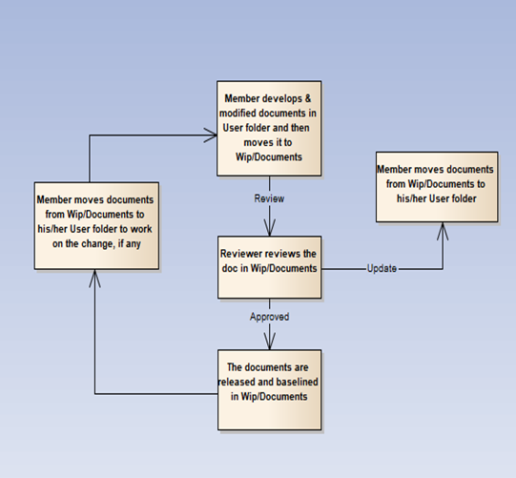
2.7 Configuration management - コンフィグレーション管理
Introduction
Project Management
SRS

Slide 21


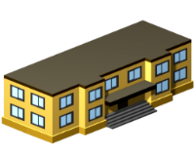





2.8 Communication management - コミュニケーション管理
Time: 5 hours/day, 5 days/week.
Location: school, home
Communication
Meeting minutes
Introduction
Project Management
SRS

Slide 22
3 - Software Requirement Specification - ソフトウェア要求仕様
Introduction
Project Management
Come up next: Ta Ngoc Duy
SRS

Slide 23


3.1 Business Actors -ビジネスアクター
There are 2 main actors
Introduction
Project Management
SRS
User
Administrator

Slide 24
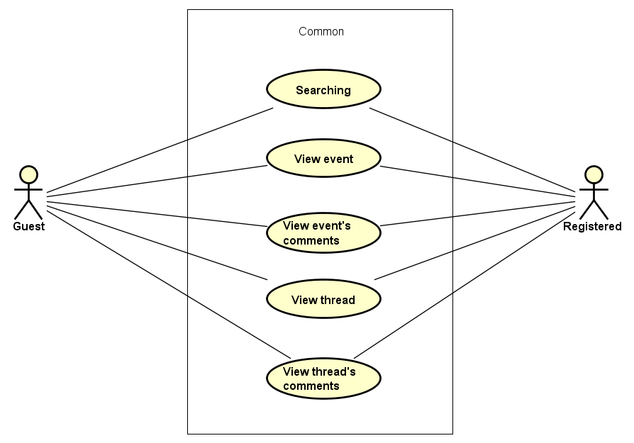
3.2 Functional Requirements - 機能要求
Introduction
Project Management
SRS
Common module

Slide 25
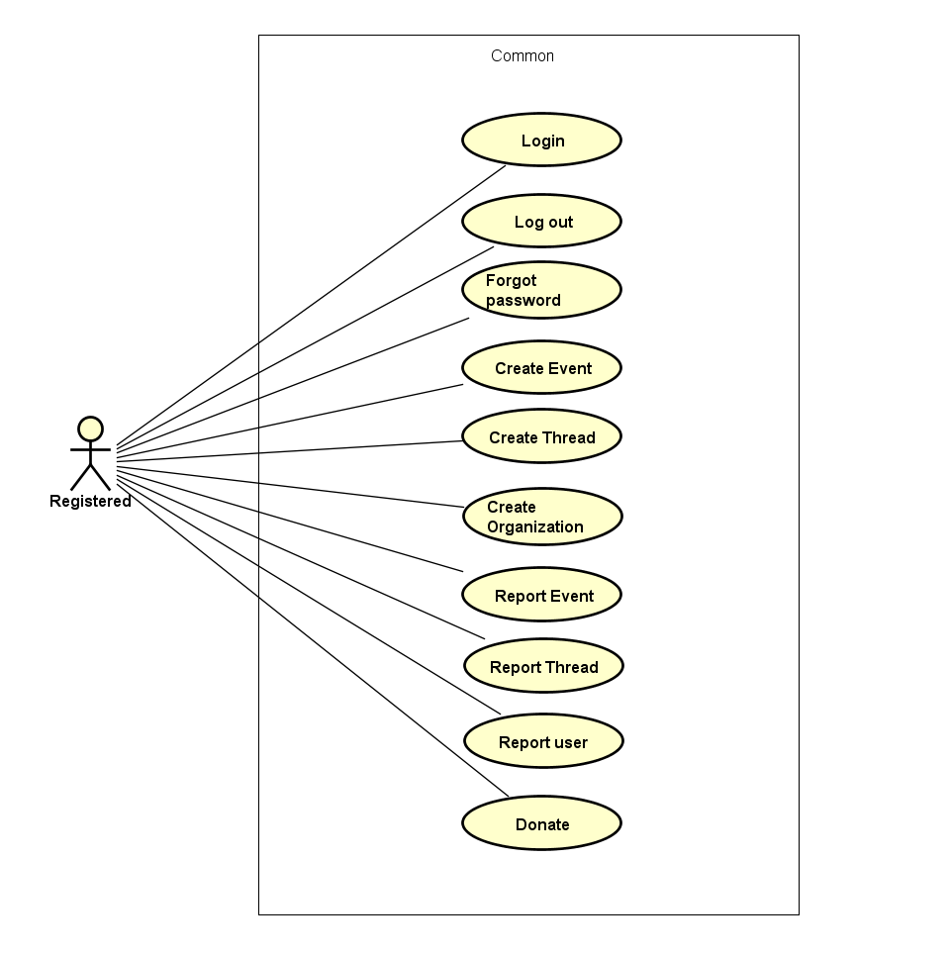
3.2 Functional Requirements - 機能要求
Introduction
Project Management
SRS
Registered common module

Slide 26
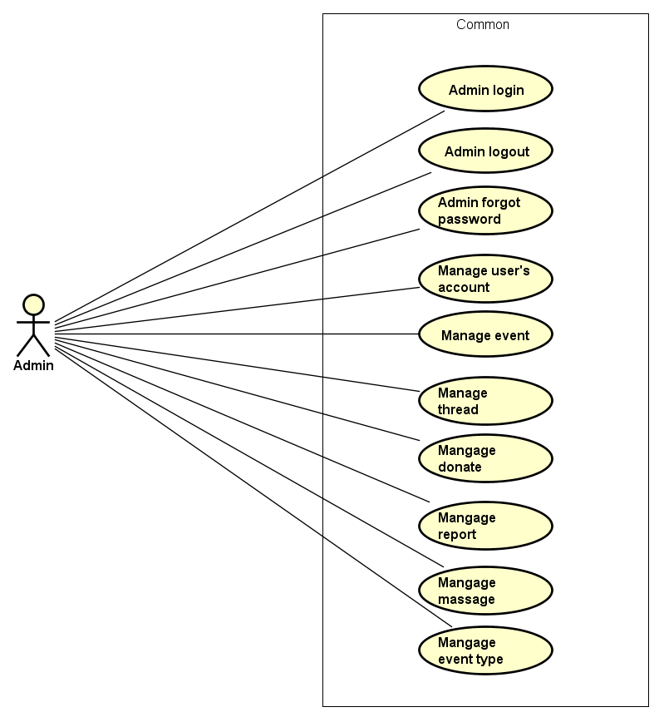
3.2 Functional Requirements - 機能要求
Introduction
Project Management
SRS
Admin module

Slide 27
3.3 Non-Functional Requirements -非機能要求
Availability
The application must be available 95% of time. Users can access to it everywhere from their Web browser with internet connection.
Maintainability.
Design
The design of the system must be loosely coupled that chances on some module will not affect others.
Usability
- User can complete each function easy with dedicated guidance of website.
- Output of the project must include coding standards and naming conventions documentations. Implementation code must be easy to maintain
Introduction
Project Management
SRS

Slide 28
3.3 Non-Functional Requirements -非機能要求
Security Requirements.
User authorize
Each function must be distributed system access and manipulate the individual parts. To edit information, user must declare their username and password before the operation. Functions will be show after users login dependencies user’s role and permission of each user.
Manage Data Layer
Only Administrator can modify database system
Introduction
Project Management
SRS

Slide 29



3.3 Non-Functional Requirements -非機能要求
Software Requirements: Browser
Hardware Requirements:
Laptop or PC
Introduction
Project Management
Chrome 54 or above
Firefox 50 or above
SRS

Slide 30



4.Software Design Description -ソフトウェア要求仕様
4.1 Architectural Representation.
4.2 Package Diagram.
4.3 Database Design.
4.4 Screen.
4.5 Class design and sequence diagram.
SDD
Quality Control
Come up next: Le Hong Nhien
SRS

Slide 31





4.1 Architectural Representation –アーキテチャ表現
Technologies and Frameworks:
SDD
Quality Control
SRS

Slide 32
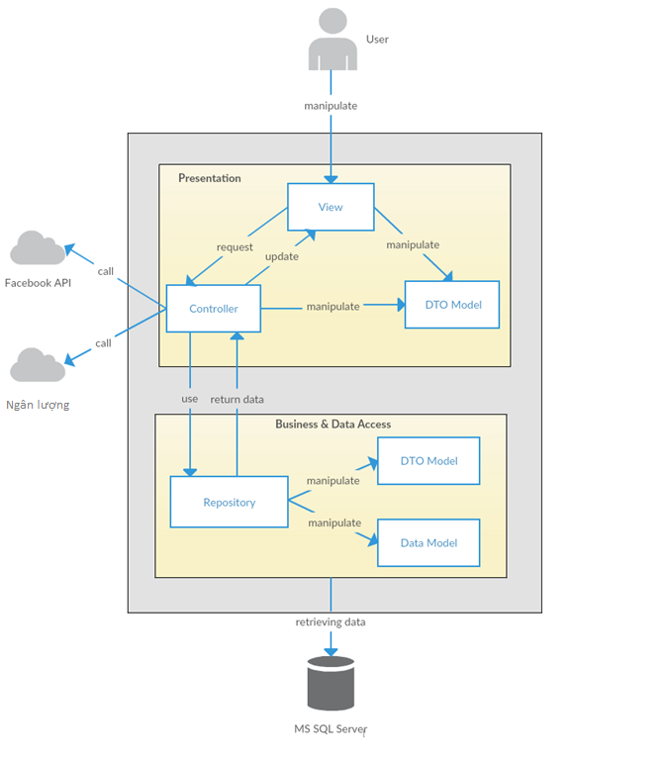
System Overall Architectural.
SDD
Quality Control
SRS

Slide 33
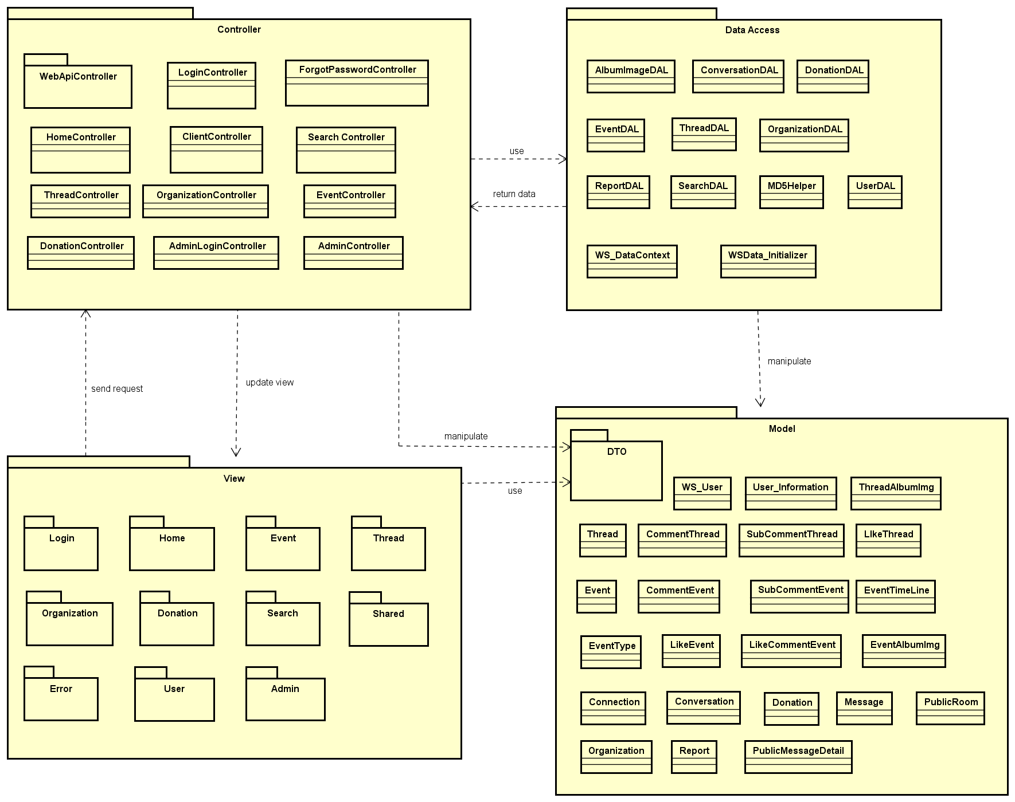
4.2 Package Diagram - パッケージ ビュ
SDD
Quality Control
SRS

Slide 34
4.3 Database Design -データベース設計
SDD
Quality Control
SRS

Slide 35
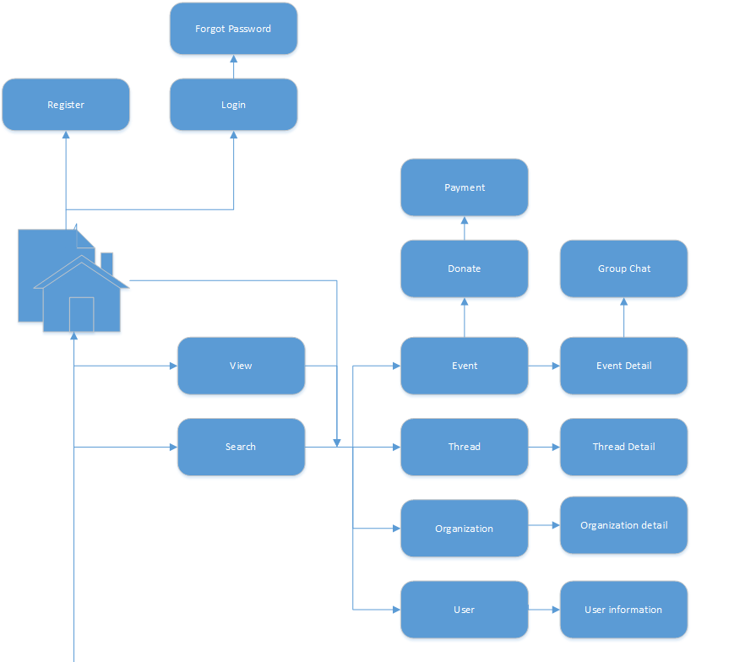
4.4.1 Screen flow - 画面の流れ
SDD
Quality Control
SRS

Slide 36
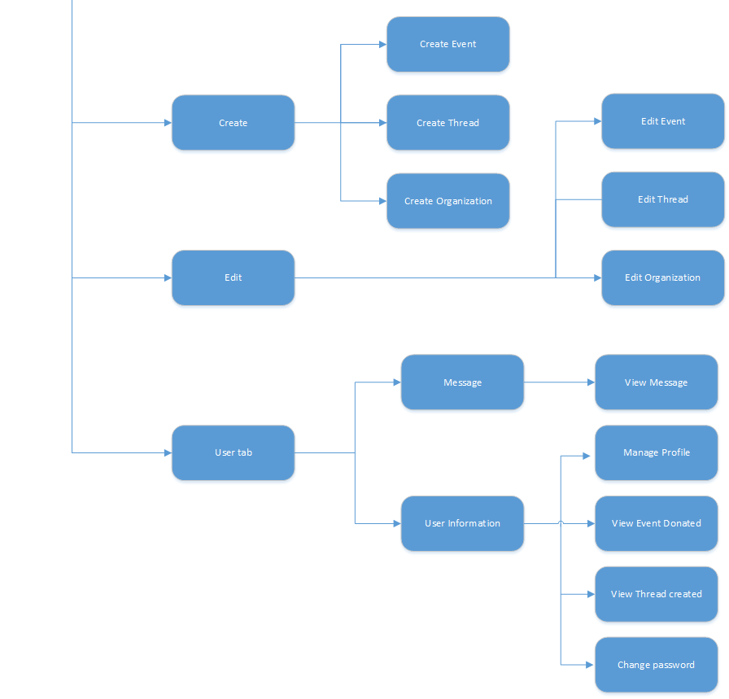
SDD
Quality Control
SRS
Screen flow for user

Slide 37
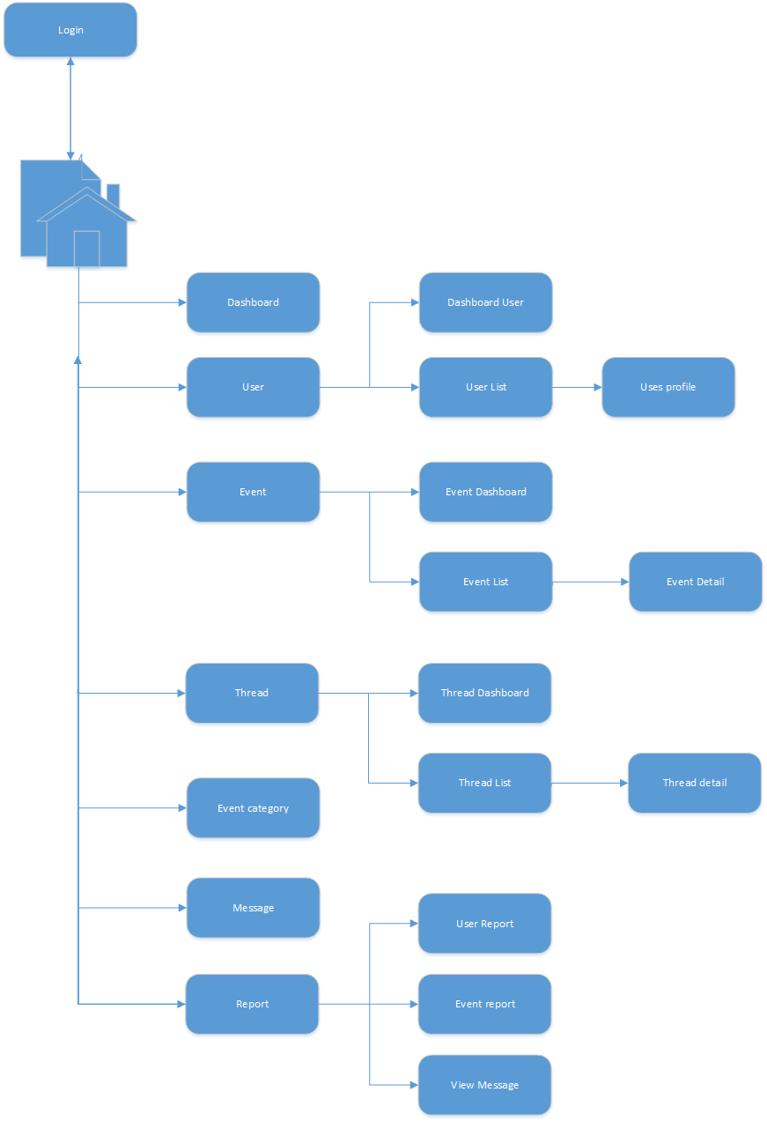
SDD
Quality Control
SRS
Screen flow for admin

Slide 38
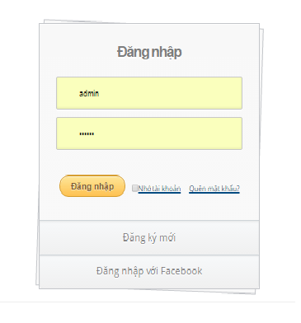
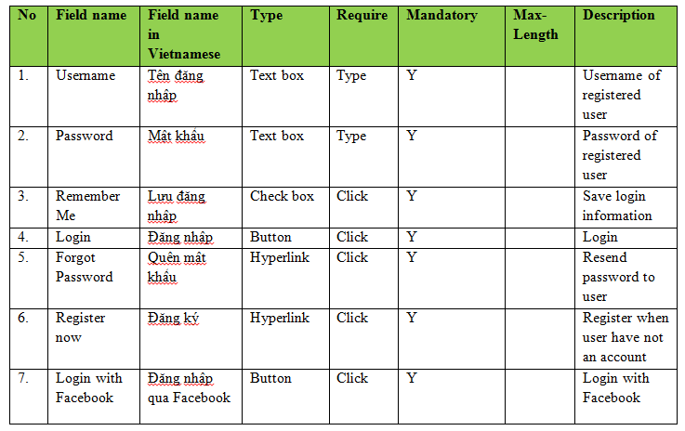
4.4.2 Screen design - 画面設計
SDD
Quality Control
SRS
Screen design for login

Slide 39
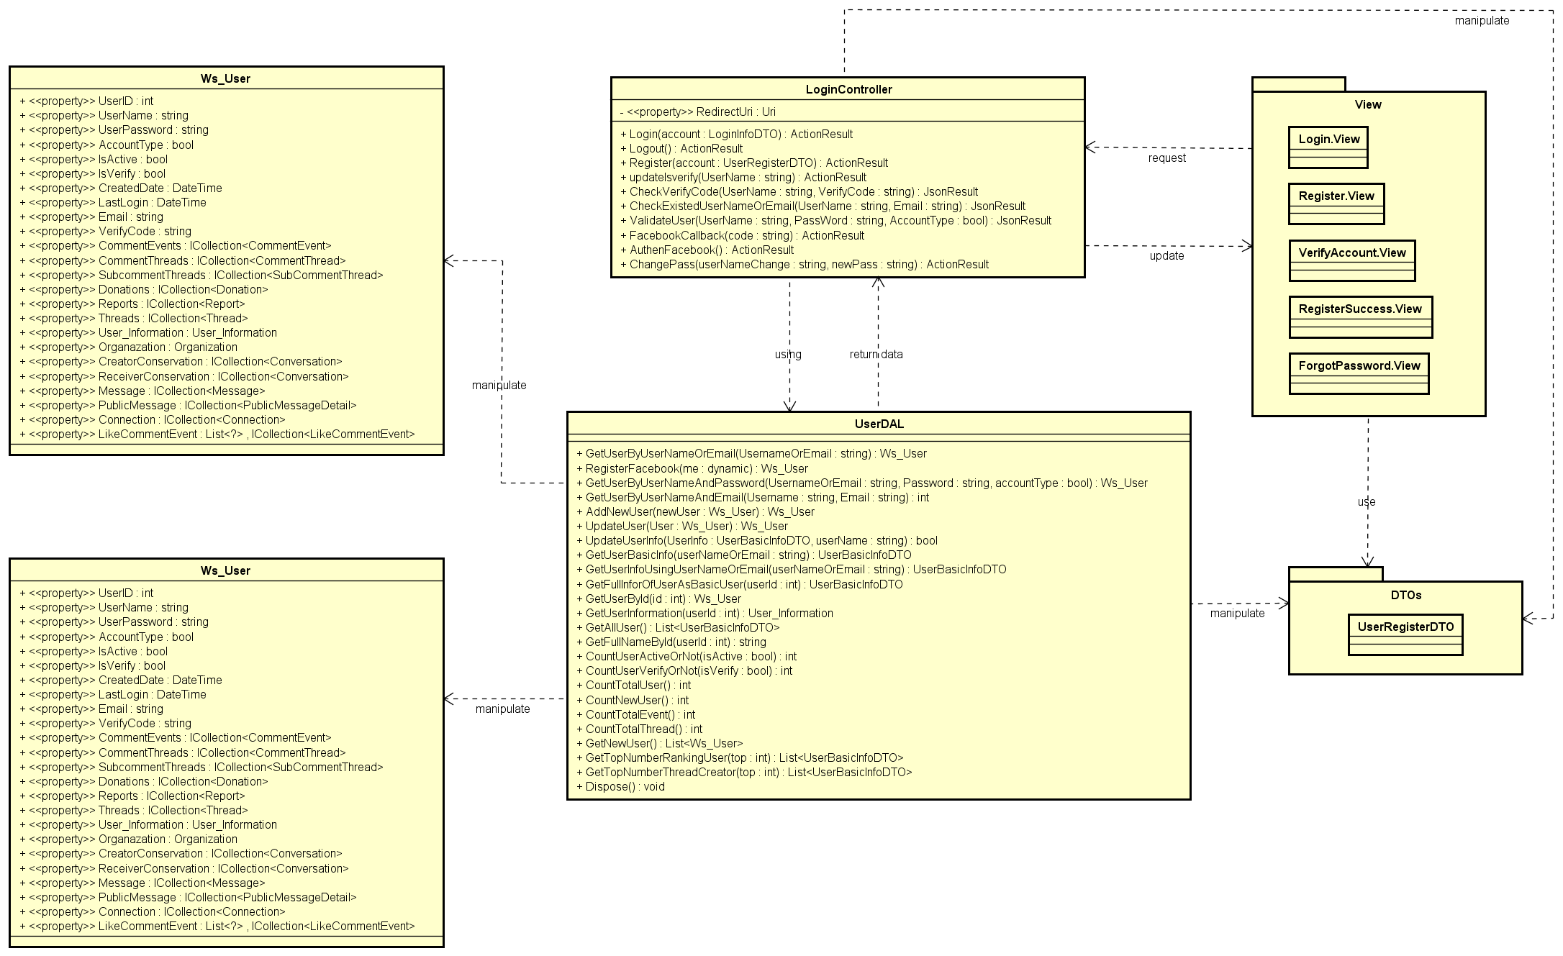
4.5.1 Class design -クラス設計
SDD
Quality Control
SRS
Login class design

Slide 40
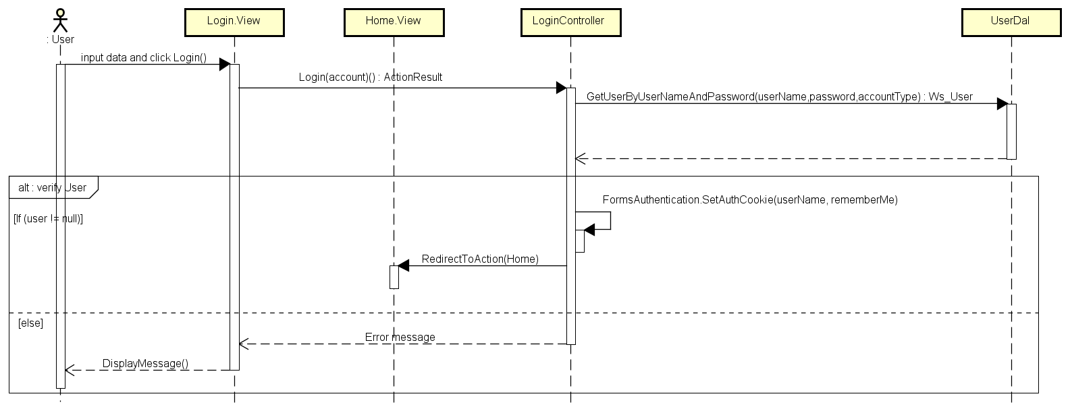
4.5.2 Sequence diagram -シーケンス図
SDD
Quality Control
SRS
Login sequence diagram

Slide 41

5. Quality Control
SDD
Quality Control
Come up next: Ta Ngoc Duy
Project Result

Slide 42
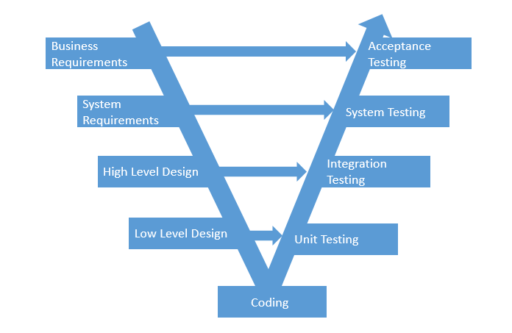
SDD
Quality Control
Project Result
V-model process

Slide 43
5.1 Review
5.1.2 SRS
5.1.3 Design
5.1.4 Code
5.2 Testing
5.2.1Test Process
5.2.2Test Report
5.1.5 Test Document
5.1.1 Project Plan
SDD
Quality Control
Project Result

Slide 44
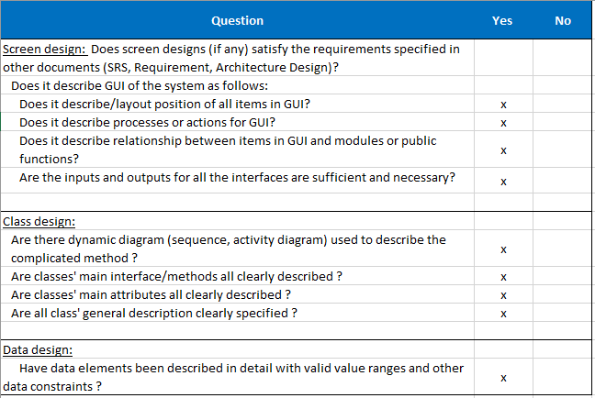
5.1 Review
SDD
Quality Control
Project Result
Design review

Slide 45
5.2 Testing
5.2.1 Test Process -テストのプロセス
1
Create Test plan
Create Test Case
3
Review Test Case
4
Execute Test
5
Log Bug
6
Re-test
7
Create Test Report
2
SDD
Quality Control
Testing process
Project Result

Slide 46
5.2.1 Test Process -テストのプロセス
1
Create Test plan
2
Create Test Case
3
Review Test Case
4
Execute Test
5
Log Bug
6
Re-test
7
Create Test Report
SDD
Base on Project Plan, Project Schedule , SRS to create test plan:
Features to be tested
Acceptance Test Criteria
Environment
Responsibilities
Schedules
Environment
Risks and contingencies
…
Quality Control
Project Result

Slide 47
5.2.1 Test Process -テストのプロセス
1
Create Test plan
2
Create Test Case
3
Review Test Case
4
Execute Test
5
Log Bug
6
Re-test
7
Create Test Report
SDD
Test Approach:
Unit Test: Developer
Integration Test: Tester
System Test: Tester
Common Test: Tester
Test Environment:
Web :Chrome 53 or above
Firefox 50 or above
Quality Control
Acceptance test criteria:
Statement coverage: 99%
Branch coverage: 100%
Path coverage: 100%
Project Result

Slide 48
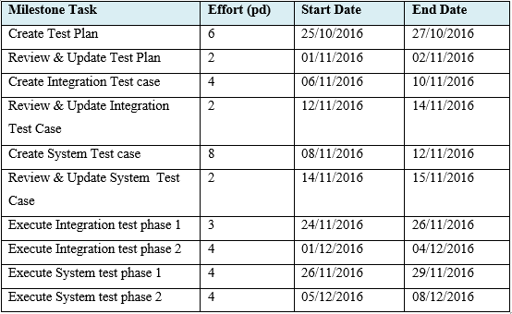
5.2.1 Test Process -テストのプロセス
1
Create Test plan
2
Create Test Case
3
Review Test Case
4
Execute Test
5
Log Bug
6
Re-test
7
Create Test Report
SDD
Quality Control
Project Result

Slide 49
5.2.1 Test Process -テストのプロセス
1
Create Test plan
2
Create Test Case
3
Review Test Case
4
Execute Test
5
Log Bug
6
Re-test
7
Create Test Report
SDD
Base on SRS, create test case:
Unit test case
Integration test case
System test case
Quality Control
Project Result

Slide 50
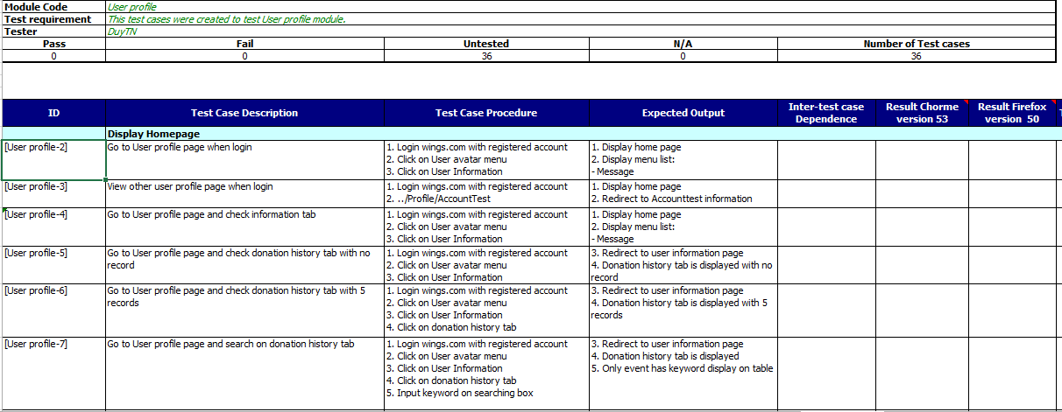
5.2.1 Test Process -テストのプロセス
SDD
Quality Control
Project Result
Test case

Slide 51
5.2.1 Test Process -テストのプロセス
1
Create Test plan
2
Create Test Case
3
Review Test Case
4
Execute Test
5
Log Bug
6
Re-test
7
Create Test Report
SDD
Developer self-review:
Unit test case
Tester self-review and peer-review:
Integration test case
System test case
Quality Control
Project Result

Slide 52
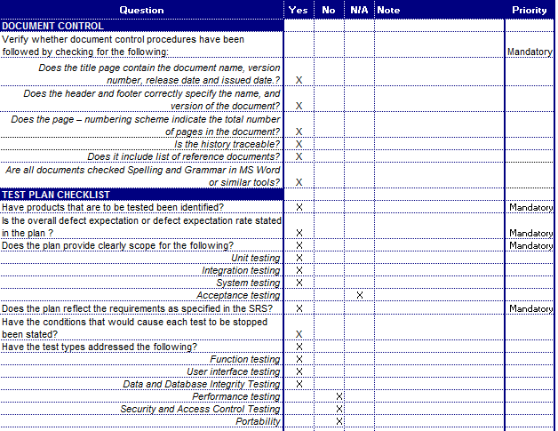
5.2.1 Test Process -テストのプロセス
SDD
Quality Control
Project Result
Test case review checklist -テストレビュー

Slide 53
5.2.1 Test Process -テストのプロセス
1
Create Test plan
2
Create Test Case
3
Review Test Case
4
Execute Test
5
Log Bug
6
Re-test
7
Create Test Report
SDD
Tester execute test case follow phase:
Unit testing
Integration testing
System testing
Quality Control
Project Result

Slide 54
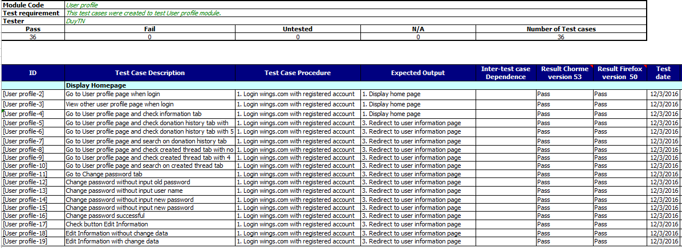
5.2.1 Test Process -テストのプロセス
SDD
Quality Control
Project Result
Test result

Slide 55
5.2.1 Test Process -テストのプロセス
1
Create Test plan
2
Create Test Case
3
Review Test Case
4
Execute Test
5
Log Bug
6
Re-test
7
Create Test Report
SDD
While executing test, tester detect, log bug and assign to appropriate developer.
Tool log bug: Hostedredmind (http://www.hostedredmine.com/)
Quality Control
Project Result

Slide 56
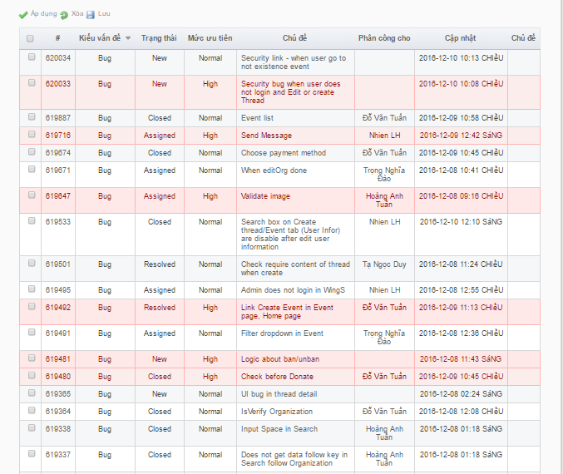
5.2.1 Test Process -テストのプロセス
Log bug
SDD
Quality Control
Project Result

Slide 57
5.2.1 Test Process -テストのプロセス
1
Create Test plan
2
Create Test Case
3
Review Test Case
4
Execute Test
5
Log Bug
6
Re-test
7
Create Test Report
SDD
When Developer fixed bug, Tester re-test until bug was fixed successfully, then change defect of status to Closed.
Quality Control
Project Result

Slide 58
5.2.1 Test Process -テストのプロセス
1
Create Test plan
2
Create Test Case
3
Review Test Case
4
Execute Test
5
Log Bug
6
Re-test
7
Create Test Report
SDD
Tester has responsibility to write test report for each test phase. Finish testing phase, Test leader create Test report
Quality Control
Project Result

Slide 59
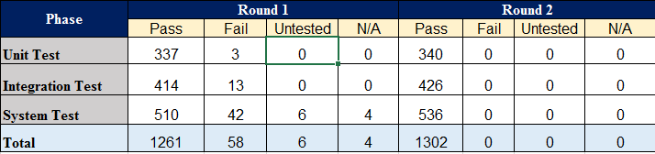
5.2.1 Test Process -テストのプロセス
SDD
Quality Control
Test report
Project Result

Slide 60
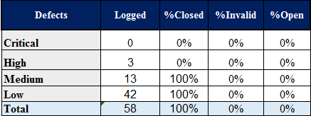
5.2.1 Test Process -テストのプロセス
SDD
Quality Control
Defect Report
Project Result

Slide 61

6. Project Summary -プロジェクト結果
Main objective | Develop a system which will provide to users functionality to makes connections that enable people to help themselves and each other by create charity topics or event as long as it follows rules to help other people.
Purpose | Provide WingS System.
Source repository | https://github.com/sangnvus/201609JS01.git
 | Plan | Actual
Start date | 05/09/2016 | 05/09/2016
End date | 16/12/2016 | 14/12/2016
Release versions | 1.0 | 1.0
Duration | 75 days | 73 days
Efforts (person day) | 375 | 365
Test cases | 1500 | 1108
Defects | 150-200 | 58
Document pages | ~ 800 pages | ~ 1500 pages
Lines of code (C#) | ~ 7000 | ~ 8000
Lines of code (HTML) | ~ 8000 | ~ 10000
Lines of code (AngularJS) | ~ 3000 | ~ 4000
LOC (Total) | ~ 18000 | ~ 22000
SDD
Quality Control
Project Result

Slide 62
6.1 Project Summary -プロジェクト概要
Knowledge:
Improve skills: teamwork, leader-ship, research and self-study, plan and manage time.
Work process of FPT Software to develop a project.
Putting the learned knowledge into project to practice.
Technical: AngularJS (Single Page Application), WebApi 2.0, ASP.Net MVC5.
Tools: Visual Studio, Tortoise Git, Enterprise Architect, Office tools, SQL tools.
SDD
Quality Control
Project Result

Slide 63
6.2 Limitation & Expectation -制限と期待
Current Limitations | Expectation in Future
Some screen can’t display well on Mobile or screen which has resolution lower or more than 1366x768. Website only support for Vietnamese language. Not support payment by mobile cards. | Support payment by mobile cards such as Viettel, Mobi, Vina, … App for Smart Phone which supports user manage projects and admin can manage system anywhere by smart phone. Expand server to avoid overload. Support multi-language.
SDD
Quality Control
Project Result

Slide 64
6.3 Lessons Learn -学んだ教訓
Combine working in group and working individual.
Be open to get the better by accept opinions from other member.
Limit and resolve conflicts between members.
Putting knowledge into project to practice.
Manage time and make the plan for anything.
Learning new technical and increase self-study ability.
SDD
Quality Control
Project Result

Slide 65
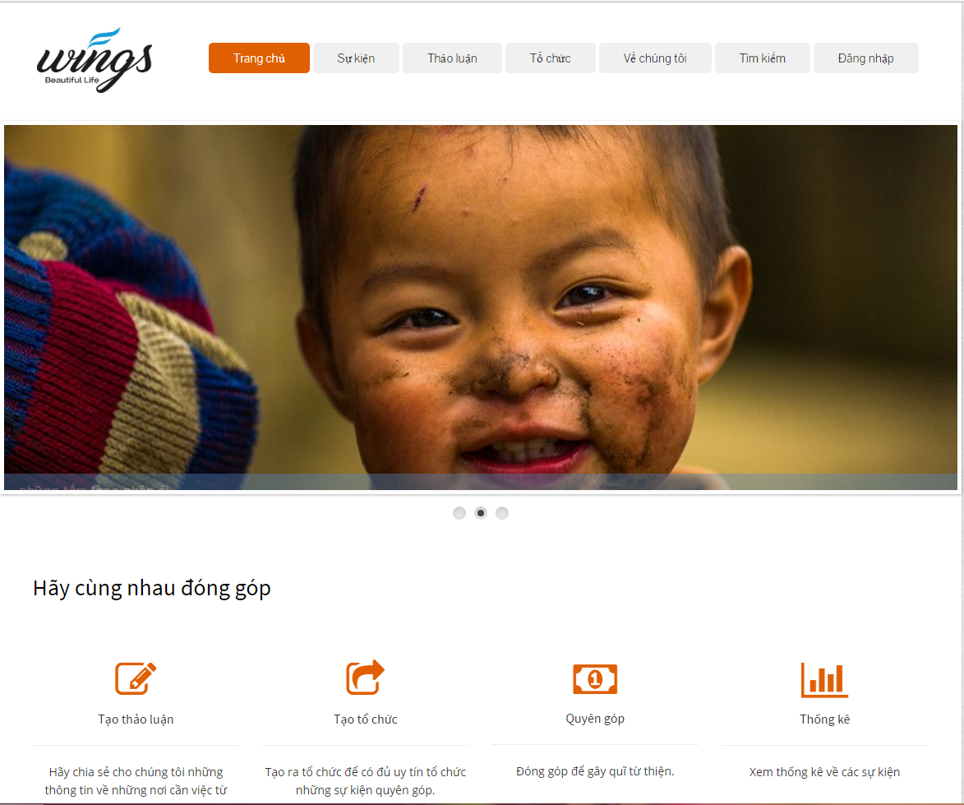

7. Demo - デモ
Demo
Q&A

Slide 66

8. Q & A -質問と回答
Demo
Q&A

